Slide 1
Classifying Thyroid Disease
Data Science Intensive Capstone Project
Rahul Ambati

Slide 2
Definition
Thyroid disease is a medical condition affecting the function of the thyroid gland. The symptoms of the disease vary depending on the type of thyroid disease.

Slide 3
Intention
A physician needs to know the demographics associated with individuals suffering from thyroid disease and find what sector of people can be focused on so that they get admitted and get prior treatment.

Slide 4
Client
Physicians who want to understand what kind of demographics, medication, etc. to consider while treating patients with thyroid disease so that the right group of people can get the proper care and treatment.

Slide 5
Data acquisition and wrangling
Data acquired from University of California Irvine Machine Learning Repository
Thyroid disease data set (https://archive.ics.uci.edu/ml/datasets/Thyroid+Disease)
Data set from the repository is clean.
It had training and test data sets.

Slide 6
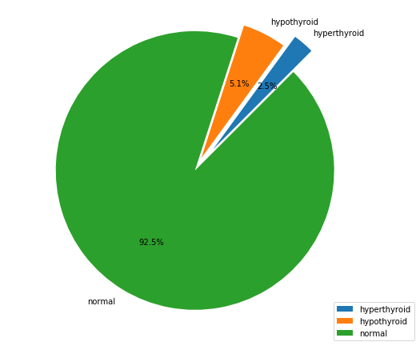
Exploratory Data analysis
Percentage of people suffering from thyroid disease is very small.
Especially hyperthyroidism is particularly low (2.5%)
Most of the population is normal.

Slide 7
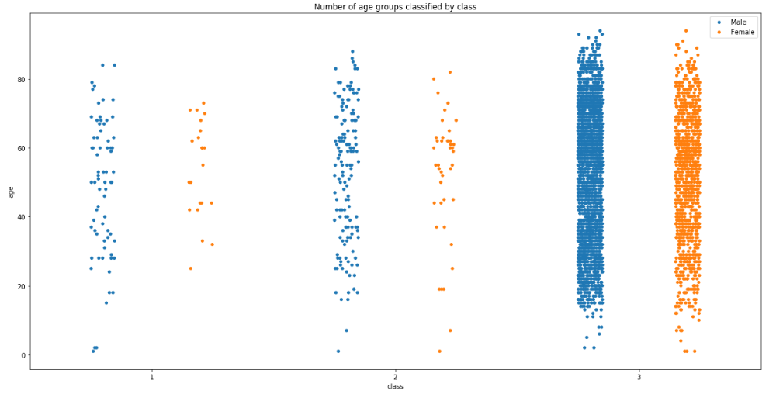
Distribution of classes per age group and gender.
Thyroid disease is spread across all age groups.
Class 1 – Hyperthyroid
Class 2 – Hypothyroid
Class 3 – Normal

Slide 8
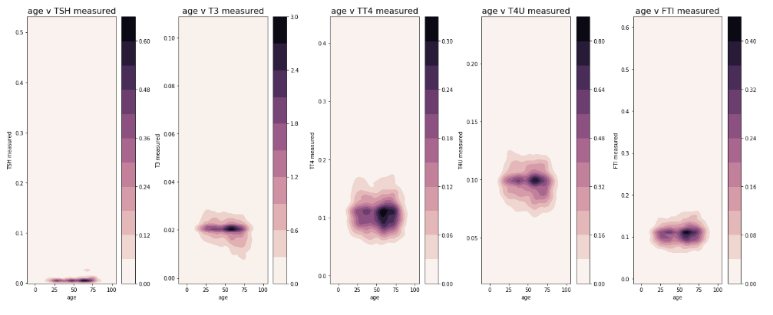
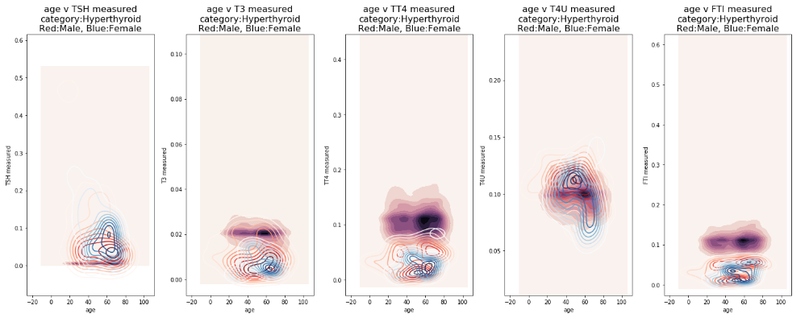
Density plots for TSH, T3, TT4, T4U, FTI measurements and age.

Slide 9
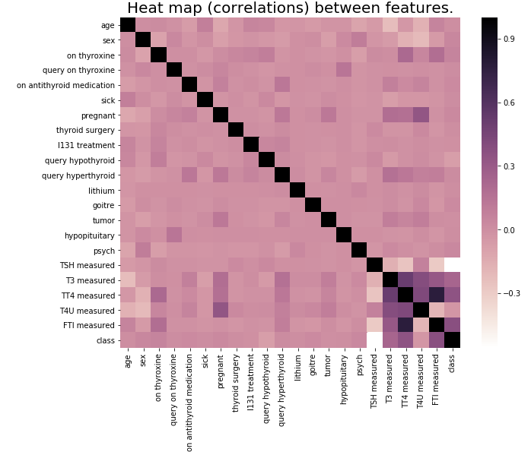
Correlation between features

Slide 10
Modeling & Machine Learning

Slide 11
Overview
Supervised learning
Multi-class Classification problem (3 classes)
Highly imbalanced data (~7.5% has thyroid disease)
Tools used: Python 3, Jupyter Notebook
Libraries used: Scikit-learn, imblearn

Slide 12
Resampling Techniques used
Resampling techniques using imblearn.
Synthetic Minority Over-sampling (SMOTE)
Random Under Sampler
Combine over- and under-sampling using SMOTE and Edited Nearest Neighbors (SMOTEENN)

Slide 13
Classification Algorithms and Techniques used
Logistic Regression
Tuning hyper-parameters
Applying Regularizations
Resampled data using SMOTE
Random Forest Classifier
Resampled data using SMOTE
Resampled data using RandomUnderSampler
Resampled data using SMOTEENN
Tuning hyper-parameters after applying SMOTE

Slide 14
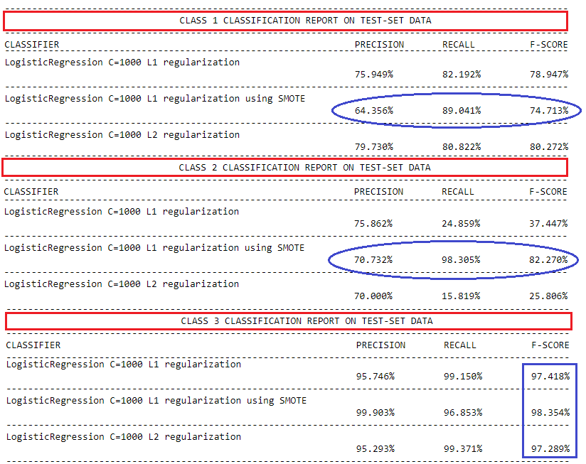
Logistic Regression
Recall for class 2 is low.
After applying SMOTE recall improved significantly.

Slide 15
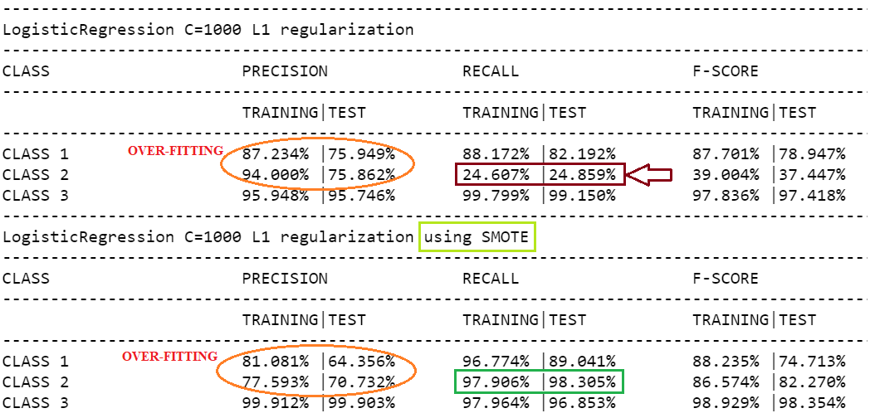
Over-fitting analysis
For Class 1 and 2 we see over-fitting happening.
After applying SMOTE difference between training and test still exists.
Class 3 has the highest metrics amongst the classes.

Slide 16
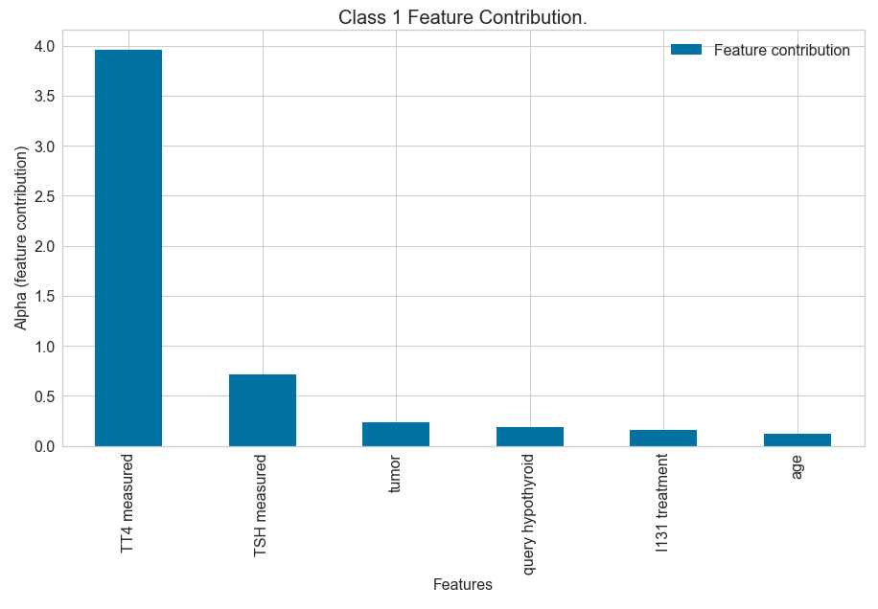
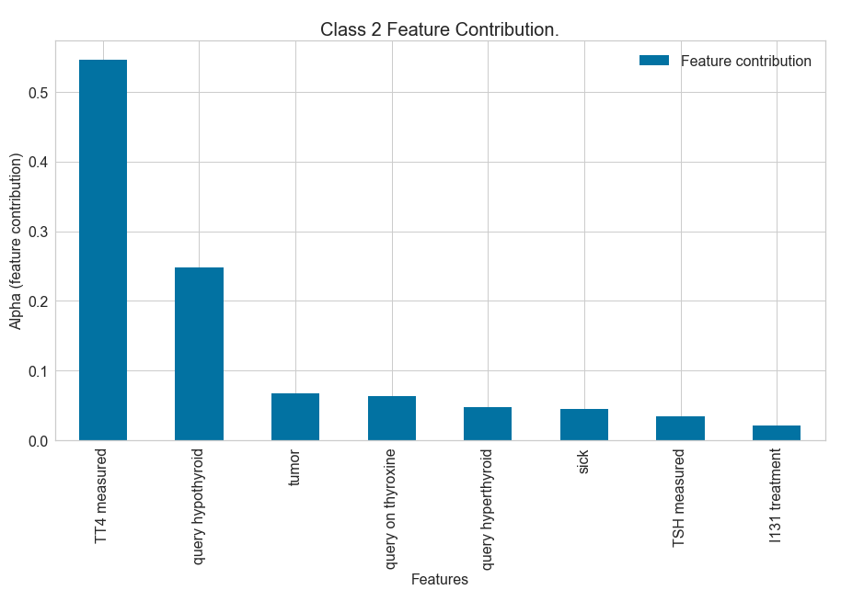
Feature Contribution

Slide 17
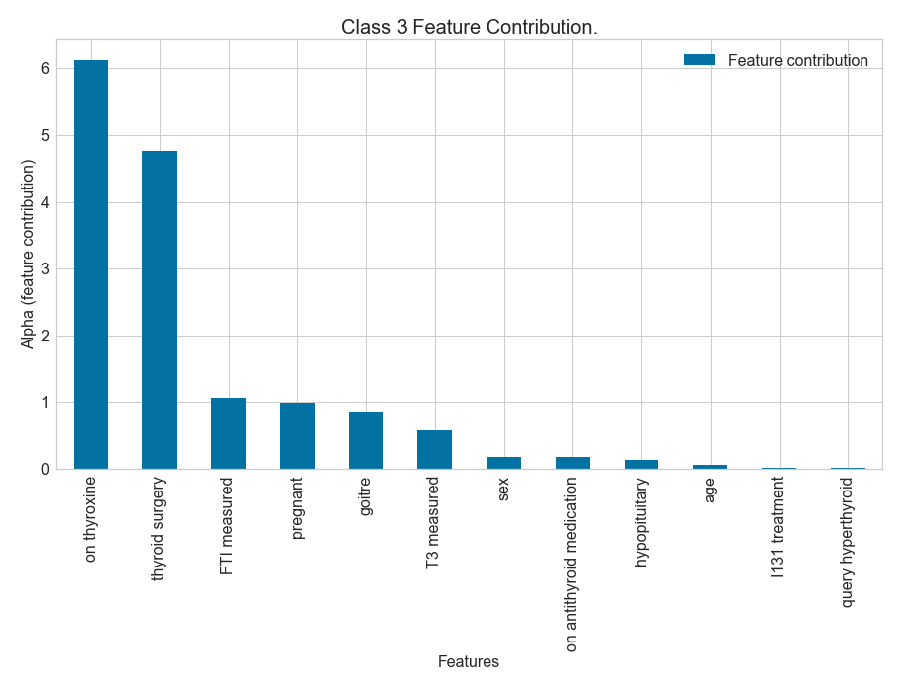

Slide 18
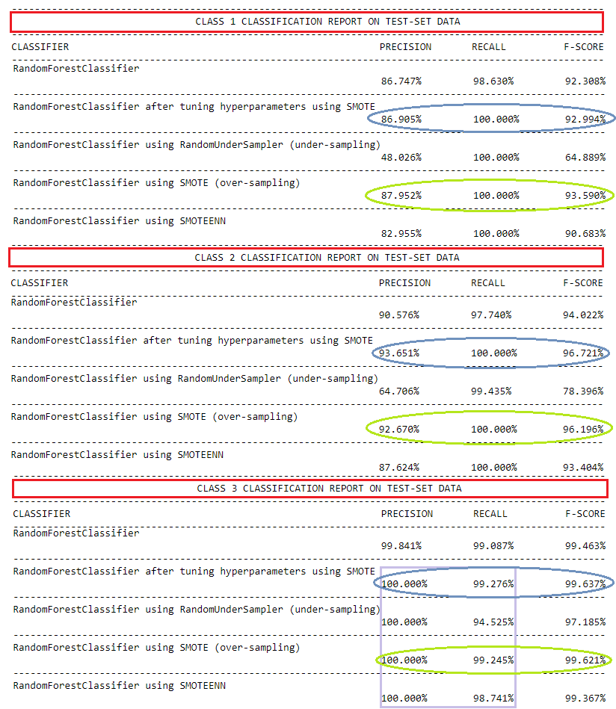
Random Forest Classifier

Slide 19
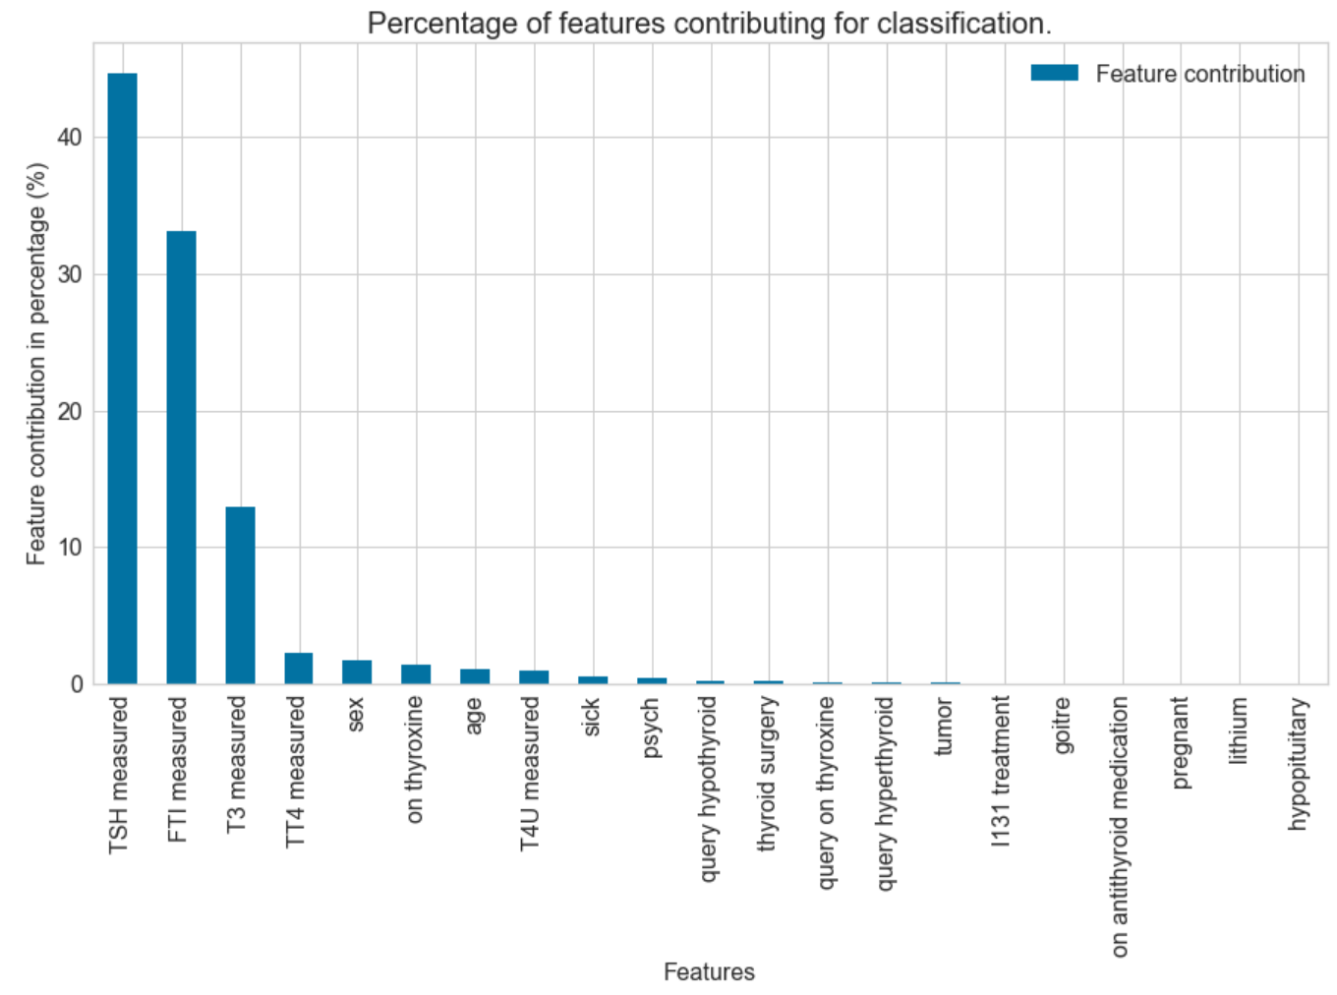
Feature Importance

Slide 20
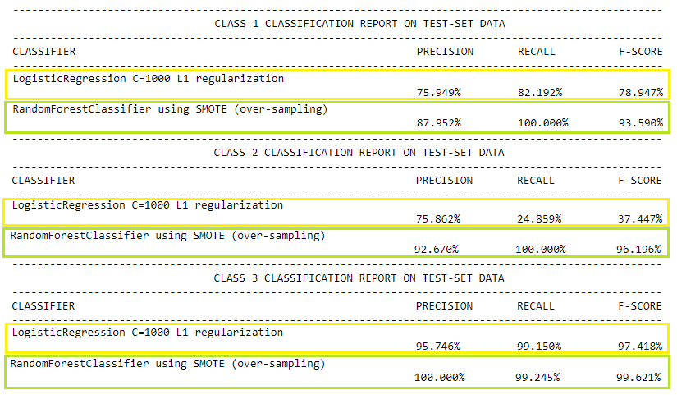
Model comparison
Base Model
Best Model

Slide 21
Findings

Slide 22
Ideas for future research

Slide 23
Recomendations

Slide 24
Thank you.

